Slide 1

Traffic Monitoring Using Radar
HARDWARE UPDATE!

Slide 2
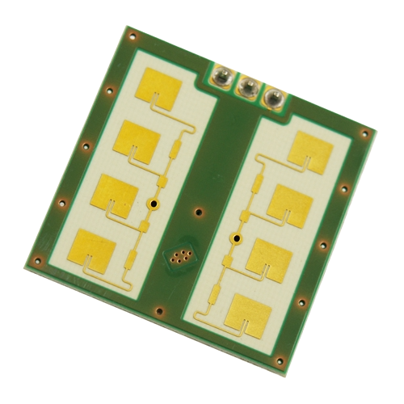
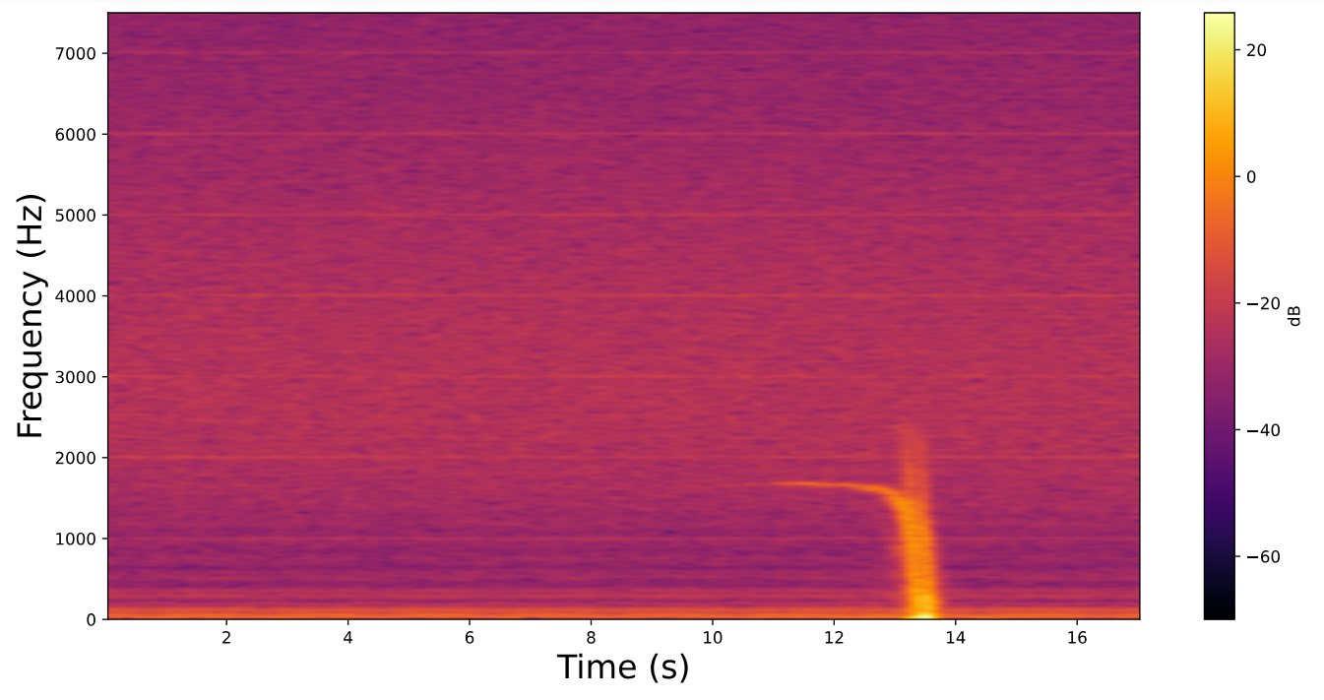
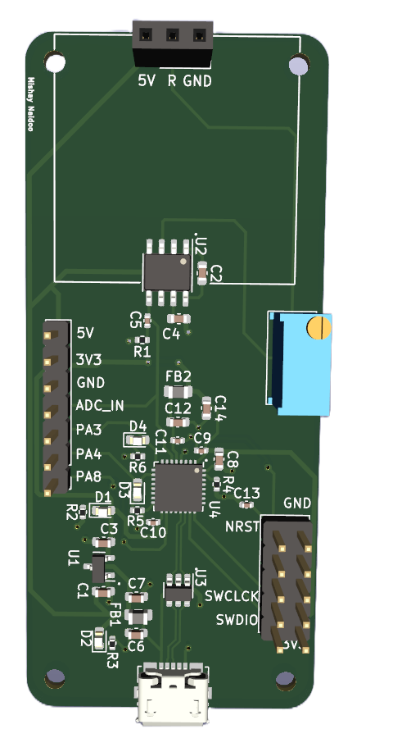
Where we left off…
Designing a standalone system to capture traffic data using the CDM324 Doppler radar
Replicate/improve the data capturing setup from 4022 using cheaper components
Designed this PCB

Slide 3
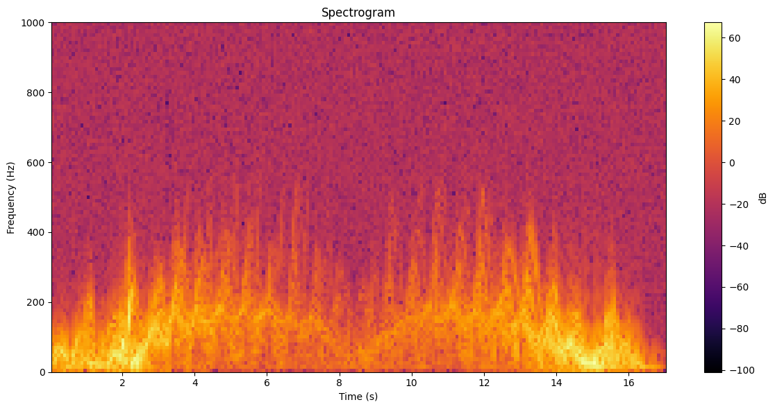

Slide 4
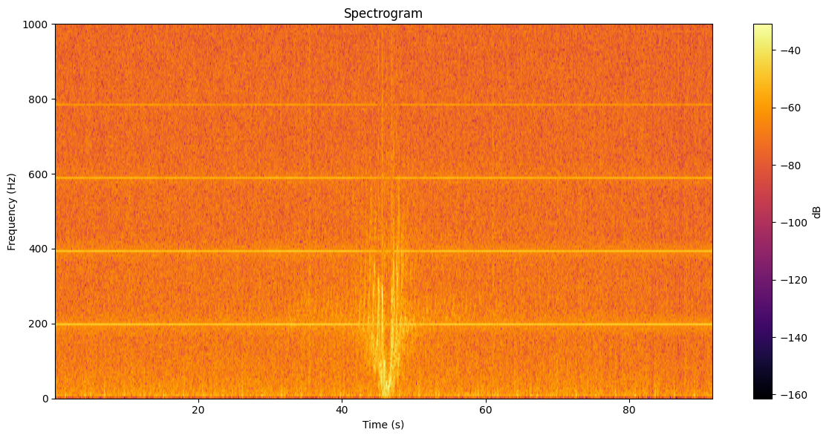


Slide 5
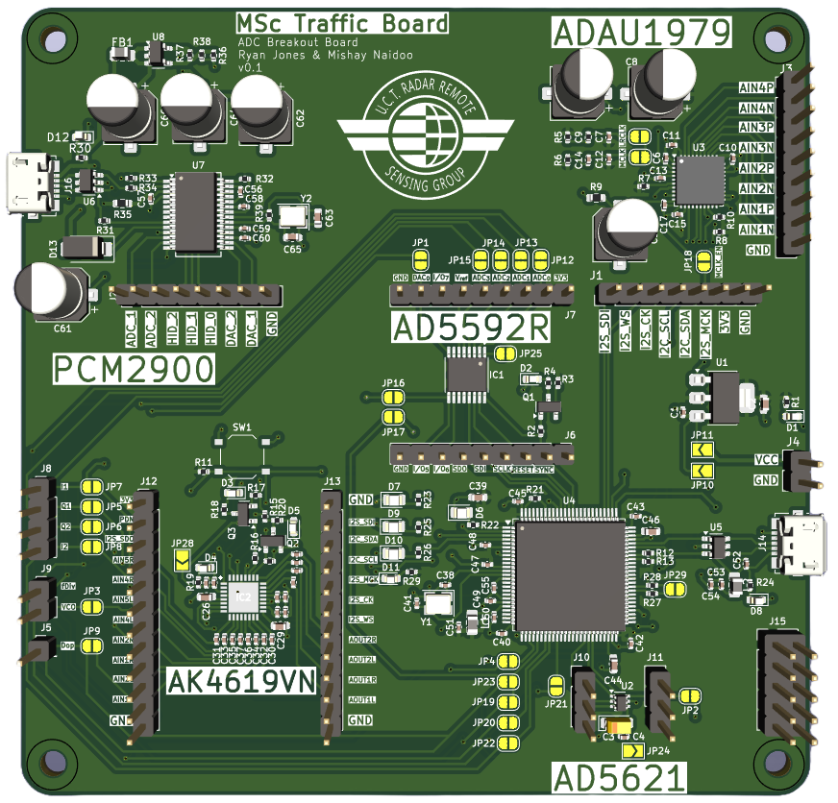
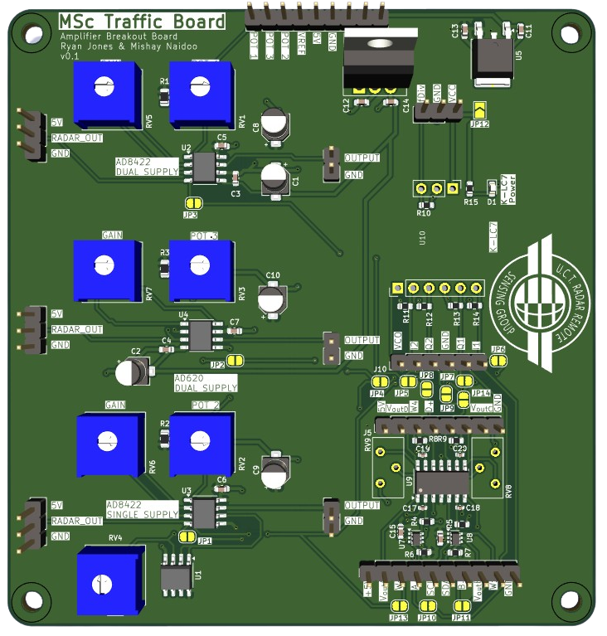
Time to Right the Ship
Design and order two separate PCBs:
ADC Board
Amplifier Board

Slide 6
ADC Board
Tested 3 ADC’s Compared to Off-the –Shelf Soundcard:
STM32H7
16 Bit ADC
Re-use Script from last board
PCM2900
16 Bit ADC
Easy USB implementation
ADAU1979
24 Bit ADC
Have to write implementation script from scratch ☹

Slide 7
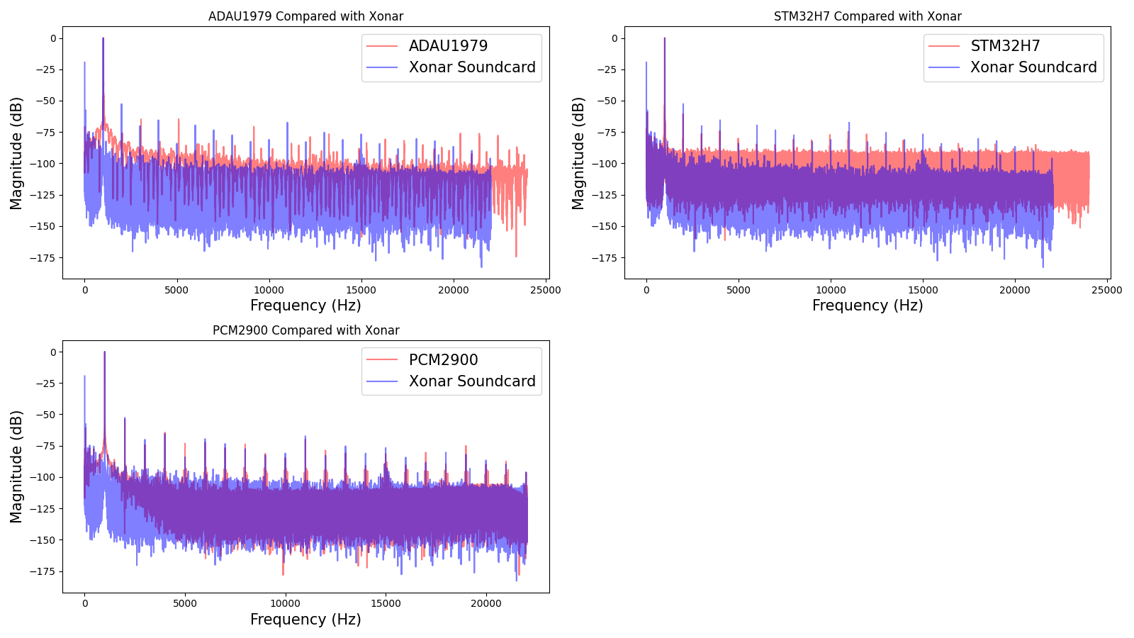

Slide 8
Amplifier Board

Slide 9
